Slide 1
Relational database design

Slide 2
Functional Dependency
The functional dependency is a relationship that exist between two attributes. It typically exists between the primary key and non-key attribute within a table.
X → Y
The left side of FD is known as determinant, the right side of the production is known as a dependent.
For example:
Assume we have an employee table with attributes:
Emp_Id, Emo_Name, Emp_Address.
Here Emp_Id attribute can uniquely identify the Emp_Name attribute of employee table because if we know the Emp_Id, we can tell that employee name associated with it.
Functional dependency can be written as:
Emp_Id → Emp_Name
We can say that Emp_Name is functionally dependent on Emp_Id.

Slide 3
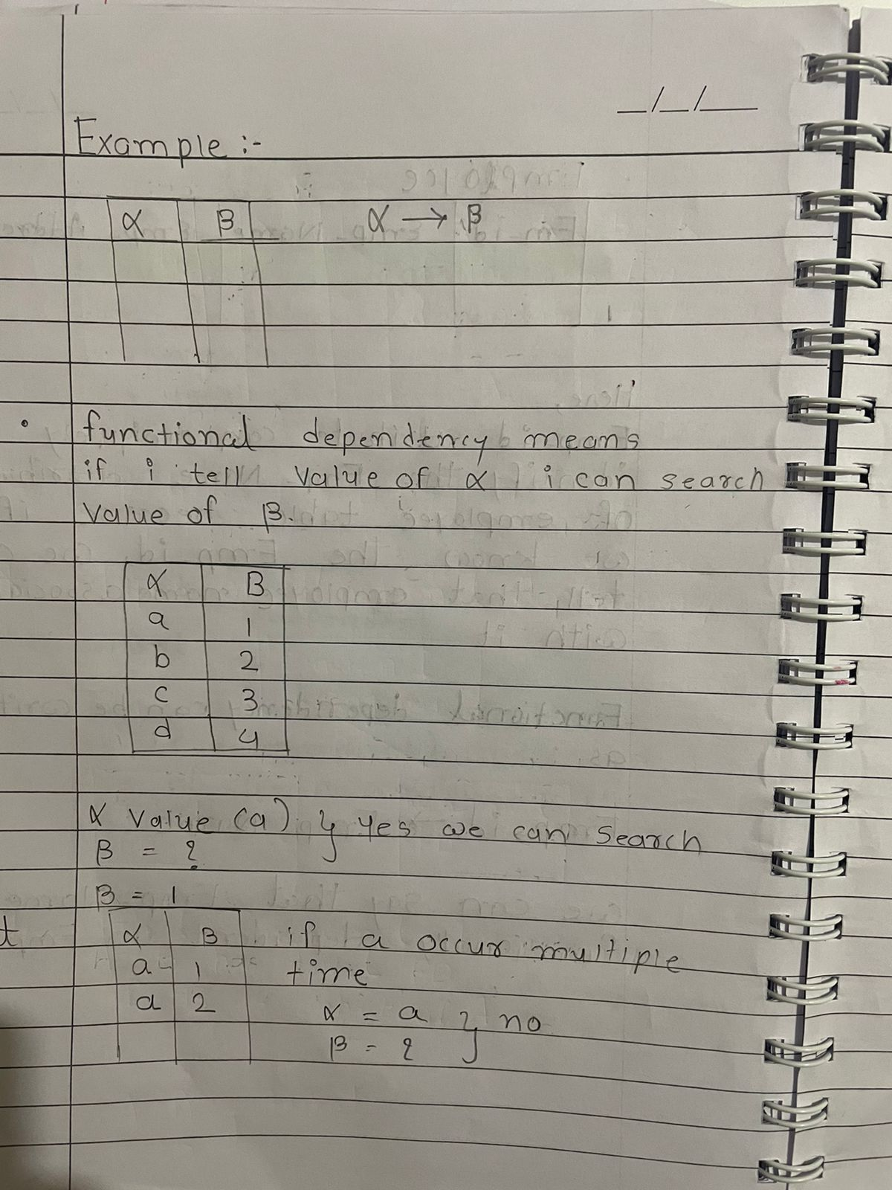

Slide 4
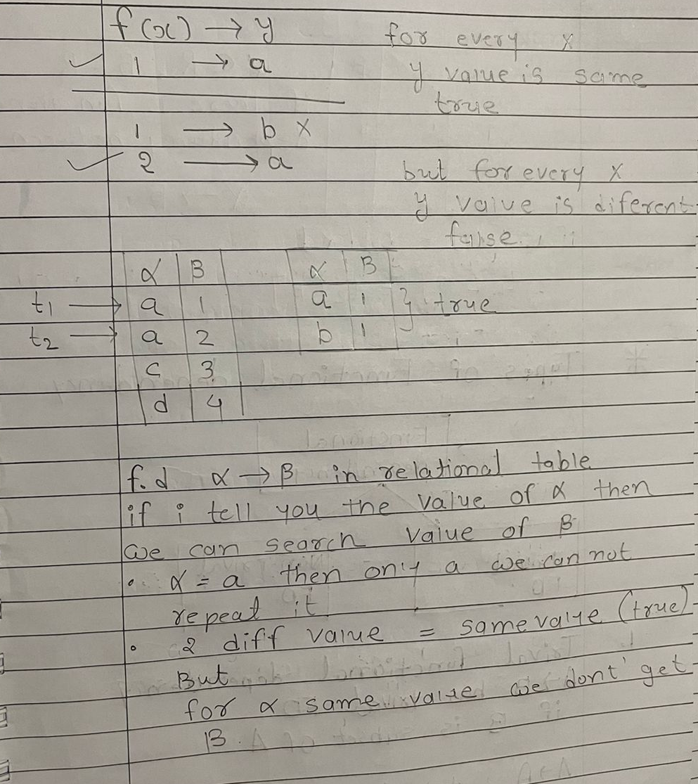

Slide 5
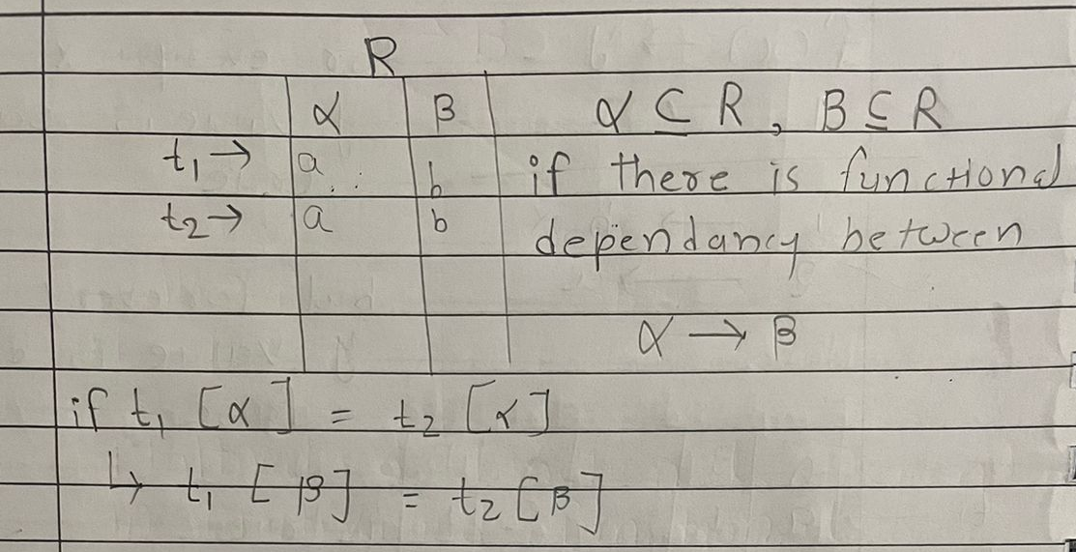

Slide 6
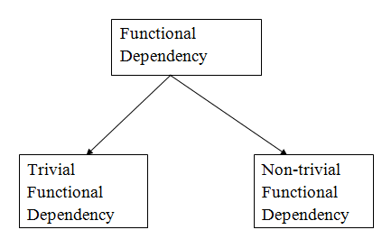
Types of Functional dependency

Slide 7
1. Trivial functional dependency
A → B has trivial functional dependency if B is a subset of A.
The following dependencies are also trivial like:
A → A, B → B
Example:
Consider a table with two columns Employee_Id and Employee_Name.
{Employee_id, Employee_Name} → Employee_Id is a trivial
functional dependency as
Employee_Id is a subset of {Employee_Id, Employee_Name}.
Also, Employee_Id → Employee_Id and Employee_Name → Employee_Name are trivial dependencies too.

Slide 8
2. Non- trivial functional dependency
A → B has a non-trivial functional dependency if B is not a subset of A.
When A intersection B is NULL, then A → B is called as complete non-trivial.
Example:
ID → Name,
Name → DOB

Slide 9
3. Multivalued Functional Dependency.
In Multivalued functional dependency, entities of the dependent set are not dependent on each other.
If a → {b, c} and there exists no functional dependency between b and c, then it is called a multivalued functional dependency.
For example,
Here, roll_no → {name, age} is a multivalued functional dependency, since the dependents name & age are not dependent on each other(i.e. name → age or age → name doesn’t exist !)
roll_no | name | age
42 | abc | 17
43 | pqr | 18
44 | xyz | 18
45 | abc | 19

Slide 10
4. Transitive Functional Dependency.
In transitive functional dependency, dependent is indirectly dependent on determinant.
f a → b & b → c, then according to axiom of transitivity, a → c. This is a transitive functional dependency
For example,
Here, enrol_no → dept and dept → building_no, Hence, according to the axiom of transitivity, enrol_no → building_no is a valid functional dependency. This is an indirect functional dependency, hence called Transitive functional dependency.
enrol_no | name | dept | building_no
42 | abc | CO | 4
43 | pqr | EC | 2
44 | xyz | IT | 1
45 | abc | EC | 2

Slide 11
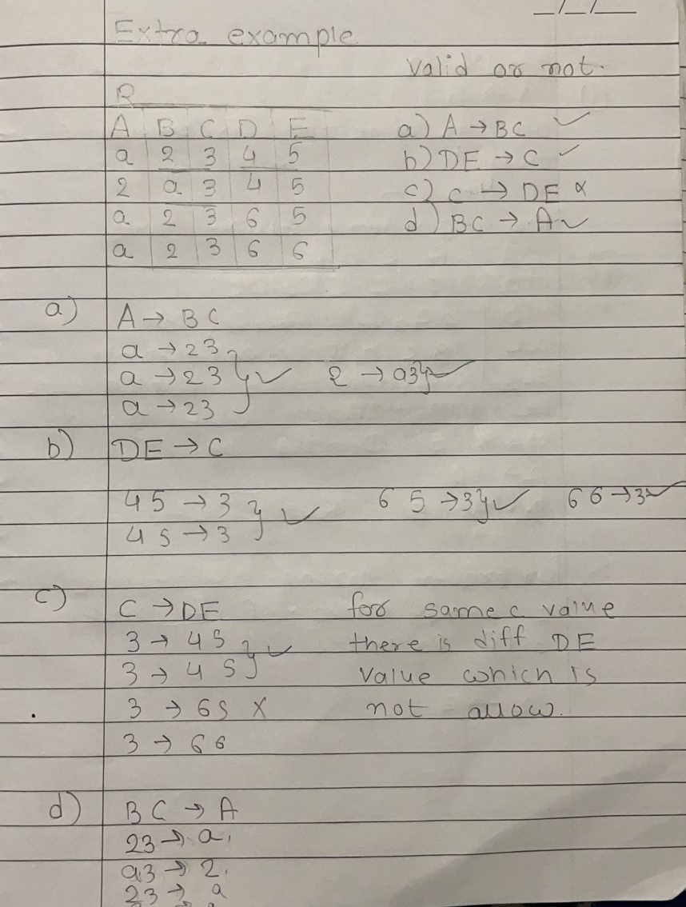

Slide 12
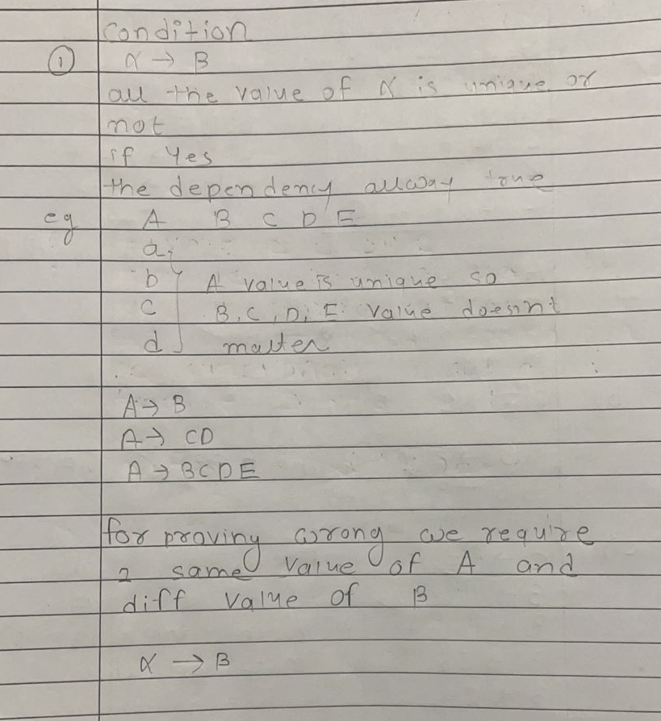

Slide 13
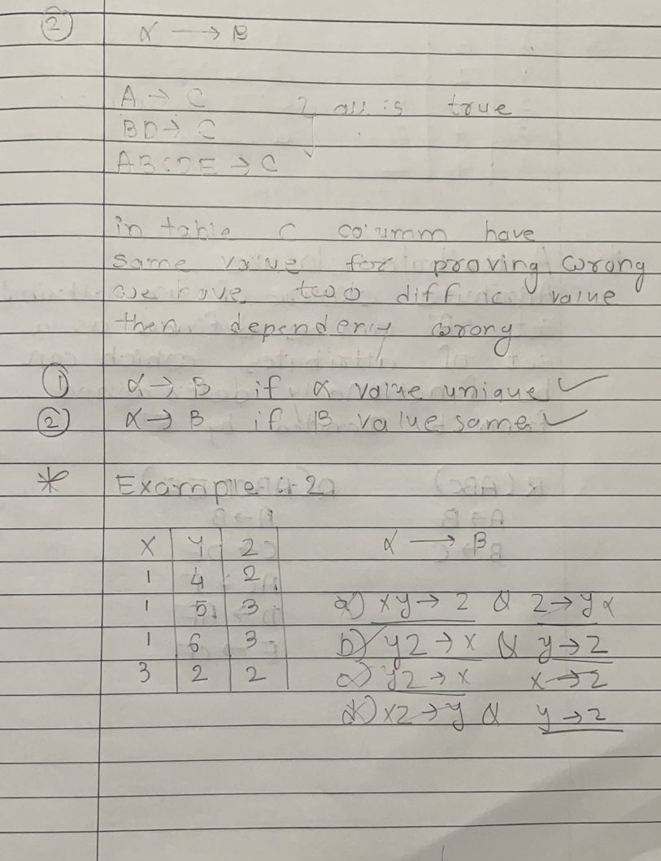

Slide 14
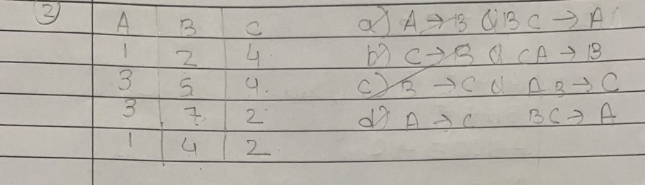

Slide 15
Attribute Closure
Attribute closure of an attribute set “A” can be define as a set of attributes which can be functionally determined from it.
Denoted by F⁺
Example : R(ABC) R(ABCDEF)
A->B A->B
B->C C->DE
AC->F
D->AF
E->CF

Slide 16
Closure of Attribute
Example-
Consider a relation R ( A , B , C , D , E , F , G ) with the functional
dependencies-
A → BC
BC → DE
D → F
CF → G
Now, let us find the closure of some attributes and attribute sets

Slide 17


Slide 18


Slide 19


Slide 20
Finding the Keys Using Closure
Super Key:
If the closure of an attribute set contain all the attribute of the relation, then that attribute set is called as a super key of that relation.
The closure of a super key is the entire relation schema.
Candidate Key:
If there exist no subset of an attribute set whose closure contains all the attributes of the relation, then that attribute set is called as a candidate key of that relation.

Slide 21
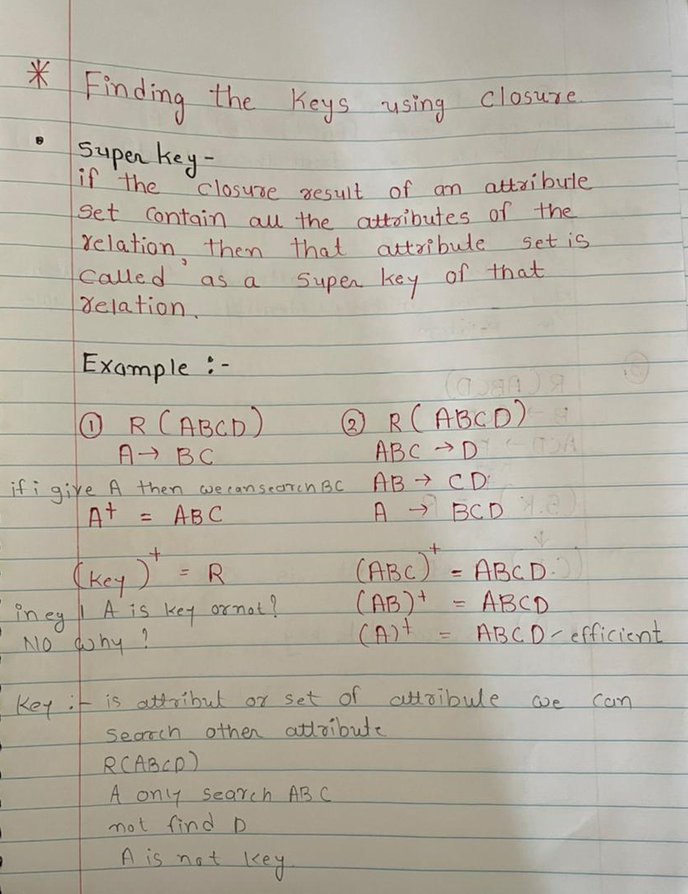

Slide 22
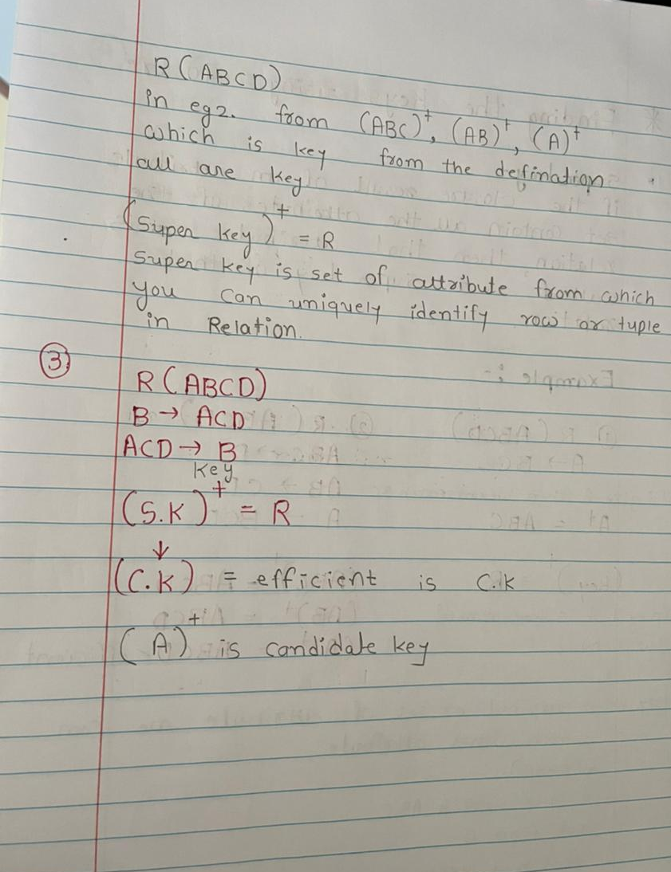

Slide 23
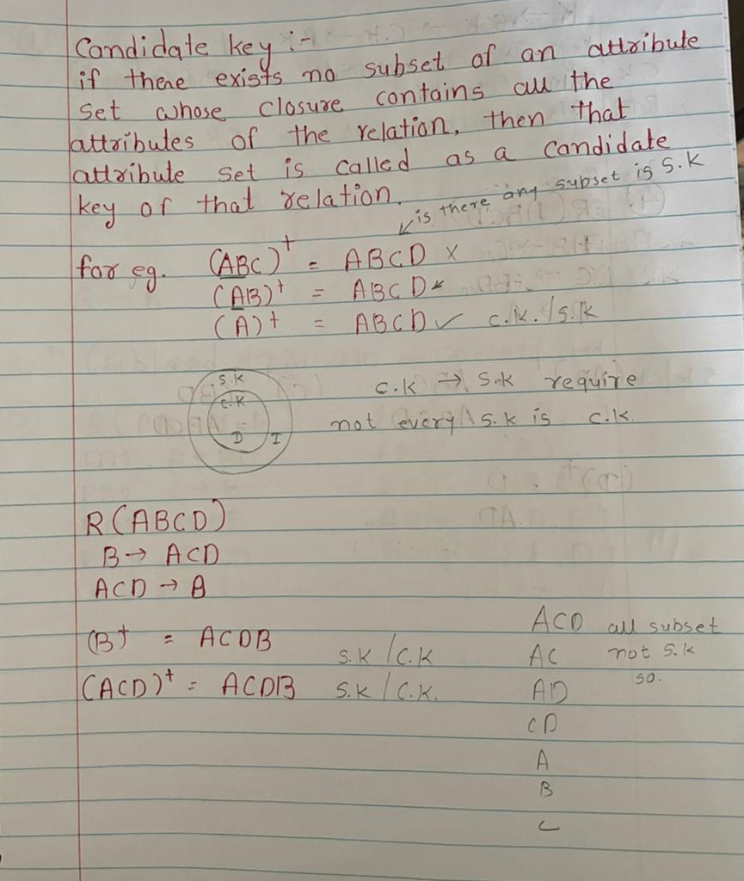

Slide 24
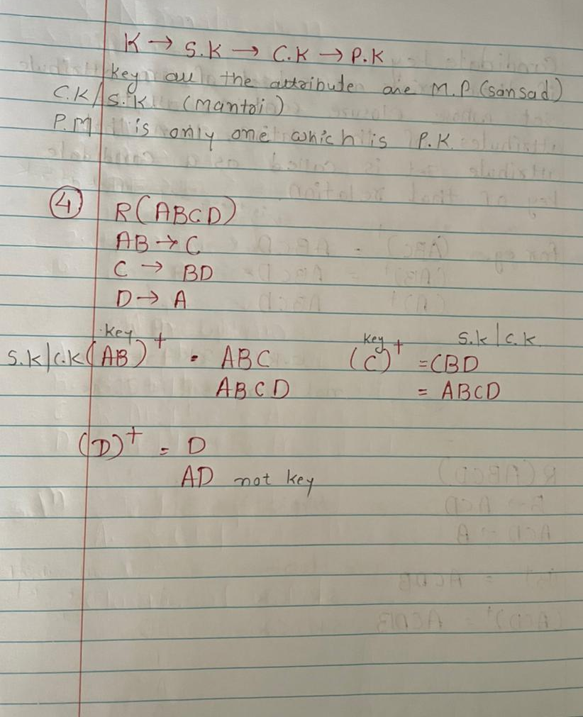

Slide 25


Slide 26


Slide 27


Slide 28


Slide 29


Slide 30


Slide 31


Slide 32


Slide 33


Slide 34


Slide 35


Slide 36
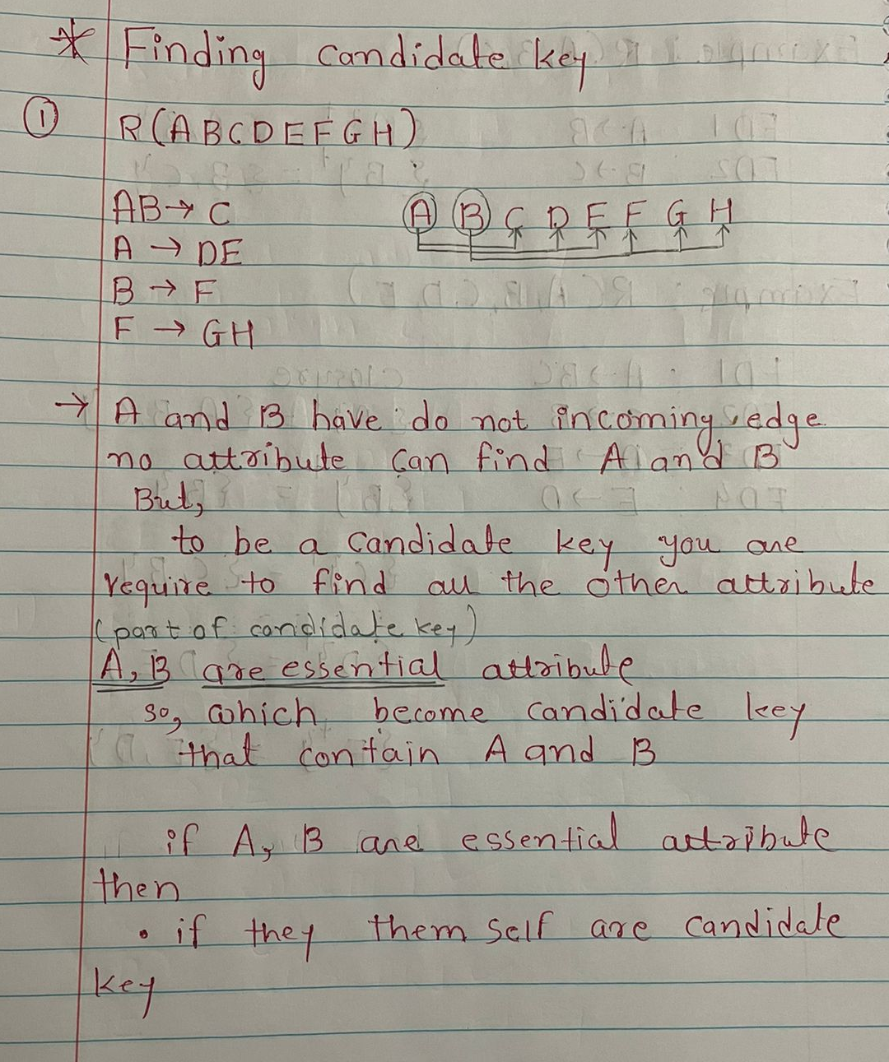

Slide 37
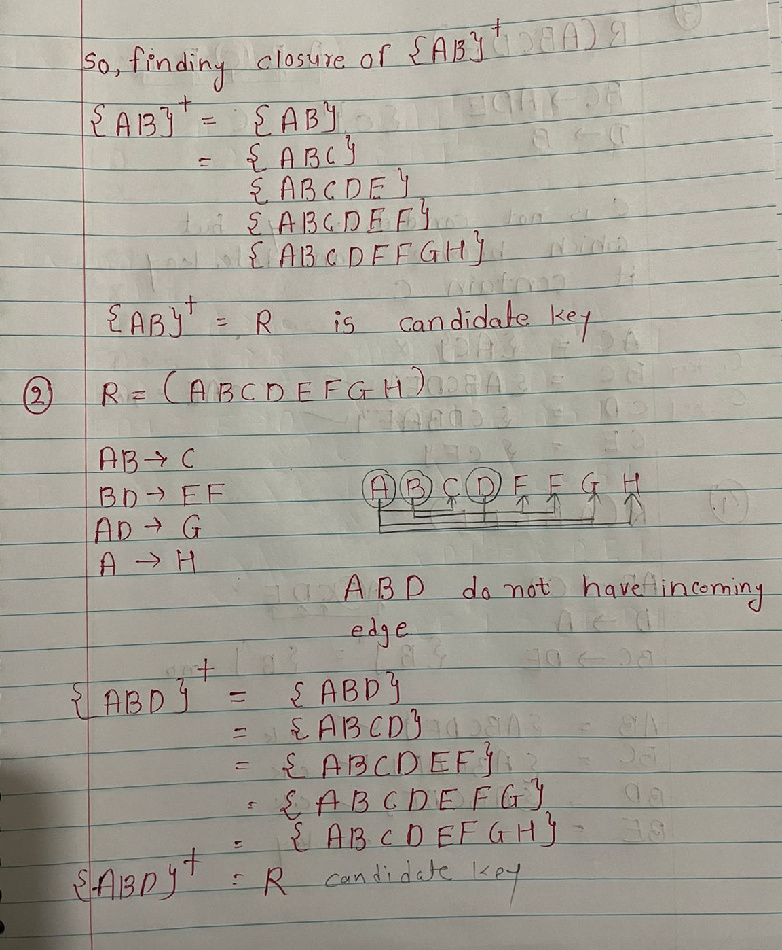

Slide 38
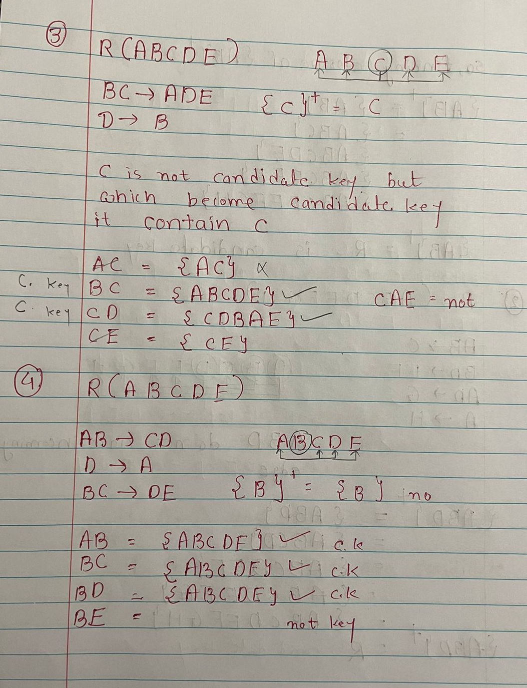

Slide 39
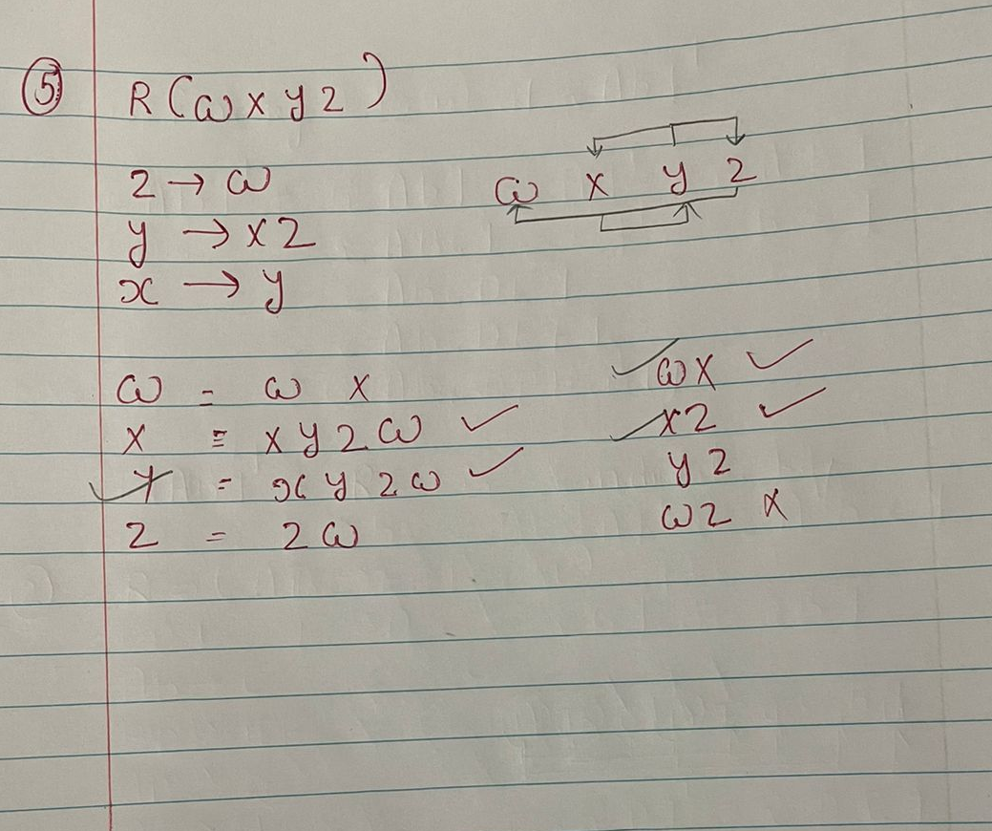

Slide 40
Armstrong axioms
Axioms is a statement that is taken to be true and serve as a premise or starting point for further arguments.
Armstrong axioms holds, on very relational database can be used to generate closure set.
The Armstrong's axioms are the basic inference rule.
Armstrong's axioms are used to conclude functional dependencies on a relational database.
The inference rule is a type of assertion. It can apply to a set of FD(functional dependency) to derive other FD.
Using the inference rule, we can derive additional functional dependency from the initial set.

Slide 41
Armstrong’s Axioms has two different set of rules
Axioms or Primary rules
Axiom of Reflexivity
Axiom of Augmentation
Axiom of Transitivity
Additional rules or Secondary rules
Union
Composition
Decomposition
Pseudo Transitivity

Slide 42
Reflexivity Rule
In the reflexive rule, if Y is a subset of X, then X determines Y.
If X ⊇ Y
then X → Y
Example:
X = {a, b, c, d, e}
Y = {a, b, c}

Slide 43
Augmentation Rule
The augmentation is also called as a partial dependency. In augmentation, if X determines Y, then XZ determines YZ for any Z.
If X → Y
then XZ → YZ
Example:
For R(ABCD), if A → B then AC → BC

Slide 44
Transitive Rule
In the transitive rule, if X determines Y and Y determine Z, then X must also determine Z.
If X → Y and Y → Z
then X → Z

Slide 45
Union Rule
Union rule says, if X determines Y and X determines Z, then X must also determine Y and Z.
If X → Y and X → Z
then X → YZ

Slide 46
Decomposition Rule
Decomposition rule is also known as project rule. It is the reverse of union rule.
This Rule says, if X determines Y and Z, then X determines Y and X determines Z separately.
If X → YZ
then X → Y and X → Z

Slide 47
Pseudo transitive Rule
In Pseudo transitive Rule, if X determines Y and YZ determines W, then XZ determines W.
If X → Y and YZ → W
then XZ → W
Proof:
X -> Y
YZ-> W
X->Y
Add z both side
So, XZ -> YZ
Where YZ =W
Prove XZ-> W
We can prove using augmentation rule and transitivity

Slide 48
Composition
If X->Y && Z->W
Then XZ->YW
X->Y Z->W
ZX->ZY ZX->WX
using union
XZ->YW

Slide 49
Normalization
Normalization is the process of organizing the data in the database to avoid data redundancy, insertion anomaly, update anomaly & delete anomaly.
Anomalies in DBMS
There are three types of anomalies that occur when the database is not normalized.
These are – Insertion, update and delete anomaly.
Lets take an example to understand this.

Slide 50
Example: Suppose a manufacturing company stores the employee details in a table named employee that has four attributes: emp_id for storing employee’s id, emp_name for storing employee’s name, emp_address for storing employee’s address and emp_dept for storing the department details in which the employee works. At some point of time the table looks like this:

Slide 51


Slide 52
Update anomaly : In the above table we have two rows for employee Rick as he belongs to two departments of the company. If we want to update the address of Rick then we have to update the same in two rows or the data will become inconsistent. If somehow, the correct address gets updated in one department but not in other then as per the database, Rick would be having two different addresses, which is not correct and would lead to inconsistent data.
Insert anomaly: Suppose a new employee joins the company, who is under training and currently not assigned to any department then we would not be able to insert the data into the table if emp_dept field doesn’t allow nulls.
Delete anomaly: Suppose, if at a point of time the company closes the department D890 then deleting the rows that are having emp_dept as D890 would also delete the information of employee Maggie since she is assigned only to this department.
To overcome these anomalies we need to normalize the data. In the next section we will discuss about normalization

Slide 53
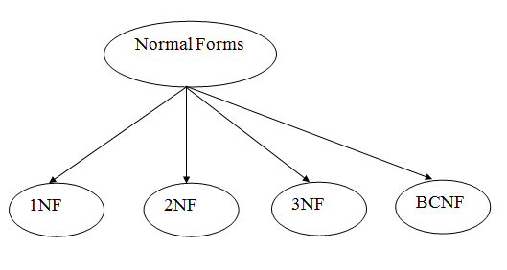
Types of Normal Forms
There are the four types of normal forms:

Slide 54
Normal Form | Description
1 NF | A relation is in 1NF if it contains an atomic value.
2NF | A relation will be in 2NF if it is in 1NF and all non-key attributes are fully functional dependent on the primary key.
3NF | A relation will be in 3NF if it is in 2NF and no transition dependency exists.
4 NF | A relation will be in 4NF if it is in Boyce Codd normal form and has no multi-valued dependency.
5 NF | A relation is in 5NF if it is in 4NF and not contains any join dependency and joining should be lossless.

Slide 55

First normal form (1NF)
As per the rule of first normal form, an attribute (column) of a table cannot hold multiple values. It should hold only atomic values.
Example: Suppose a company wants to store the names and contact details of its employees. It creates a table that looks like this:

Slide 56
Two employees (Jon & Lester) are having two mobile numbers so the company stored them in the same field as you can see in the table above.
This table is not in 1NF as the rule says “each attribute of a table must have atomic (single) values”, the emp_mobile values for employees Jon & Lester violates that rule.
To make the table complies with 1NF we should have the data like this:

Slide 57


Slide 58
Second normal form (2NF)
A table is said to be in 2NF if both the following conditions hold:
Table is in 1NF (First normal form)
No non-prime attribute is dependent on the proper subset of any candidate key of table.
An attribute that is not part of any candidate key is known as non-prime attribute.
Example: Suppose a school wants to store the data of teachers and the subjects they teach. They create a table that looks like this: Since a teacher can teach more than one subjects, the table can have multiple rows for a same teacher.

Slide 59


Slide 60
Candidate Keys:
{teacher_id, subject}
Non prime attribute: teacher_age
The table is in 1 NF because each attribute has atomic values. However, it is not in 2NF because non prime attribute teacher_age is dependent on teacher_id alone which is a proper subset of candidate key. This violates the rule for 2NF as the rule says “no non-prime attribute is dependent on the proper subset of any candidate key of the table”.
To make the table complies with 2NF we can break it in two tables like this:

Slide 61


Slide 62


Slide 63
Third Normal form (3NF)
A table design is said to be in 3NF if both the following conditions hold:
Table must be in 2NF
Transitive functional dependency of non-prime attribute on any super key should be removed.
In other words 3NF can be explained like this: A table is in 3NF if it is in 2NF and for each functional dependency X-> Y at least one of the following conditions hold:
X is a super key of table
Y is a prime attribute of table
Example: Suppose a company wants to store the complete address of each employee, they create a table named employee_details that looks like this:

Slide 64


Slide 65
Super keys:
{emp_id},
{emp_id, emp_name},
{emp_id, emp_name, emp_zip}…so on
Candidate Keys: {emp_id}
Here, emp_state, emp_city & emp_district dependent on emp_zip. And, emp_zip is dependent on emp_id that makes non-prime attributes (emp_state, emp_city & emp_district) transitively dependent on super key (emp_id). This violates the rule of 3NF.
To make this table complies with 3NF we have to break the table into two tables to remove the transitive dependency:

Slide 66


Slide 67


Slide 68
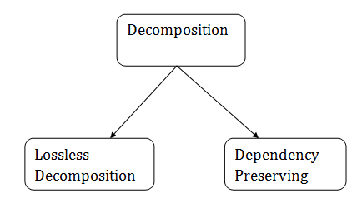
Types of Decomposition

Slide 69
Lossless Decomposition
When we do normalization on table we decompose table in to multiple table for eg. Table R(ABCD) after normalization R1(AB), R2(D).
When we have child table we remove parent table.
But, in future when we combine this two table R1 and R2 then do we get parent table?
If YES then lossless Decomposition.
If NO then we can say that some of the information may get lost.

Slide 70
Lossless join decomposition/ non – additive:
This property guaranties that the extra or less tuple generation problem does not occur after decompaction.
It’s a mandatory property must always holds good.
Eg. R1
R
R1
R
R2
After decomposition of parent table we get child table and combine child table we get parent table.

Slide 71
If a relation R is decomposed into two relations R1 & R2, then it will be loss-less if
Union of Attributes of R1 and R2 must be equal to attribute of R. Each attribute of R must be either in R1 or in R2.
Att(R1) U Att(R2) = Att(R)
Intersection of Attributes of R1 and R2 must not be
NULL. Att(R1) ∩ Att(R2) ≠ Φ
Common attribute must be a key for at least one relation (R1 or R2)
Att(R1) ∩ Att(R2) -> Att(R1) or
Att(R1) ∩ Att(R2) -> Att(R2)

Slide 72
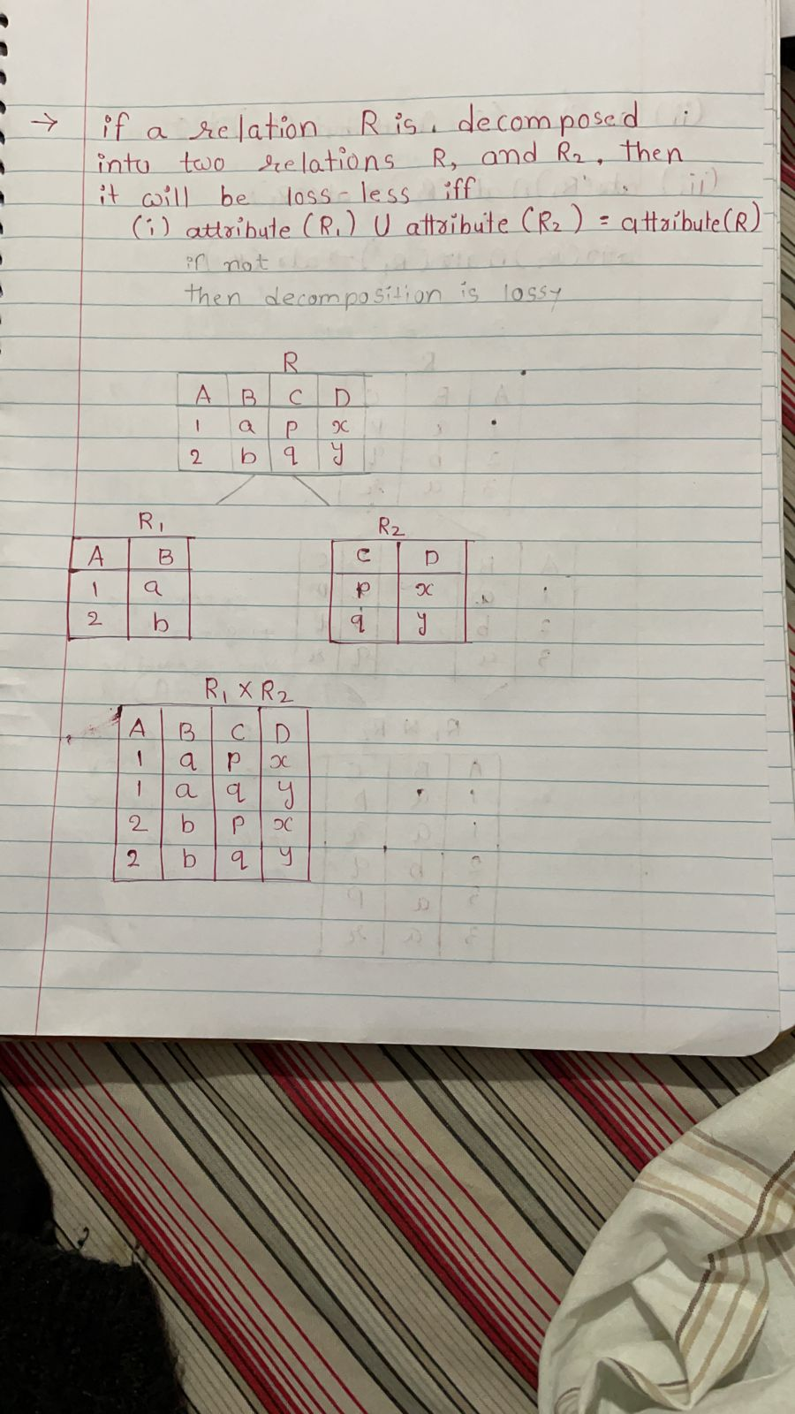

Slide 73
Example
R1(AB), R2(CD)
R1(ABC), R2(DE)
R1(ABC), R2(CDE)
R1(ABCD), R2(ABCDE)
R1(ABCD), R2(DE)
R1(ABC), R2(BCD), R3(DE)
A | B | C | D | E
A | 122 | 1 | p | W
B | 234 | 2 | Q | X
A | 568 | 1 | R | Y
C | 347 | 3 | S | Z

Slide 74
Using functional dependency
R(VWXYZ)
Z -> Y
Y -> Z
X -> YV
VW -> X
R1(VWX) R2(XYZ)
R1(VW) R2(YZ)
R1(VWX) R2(YZ)
R1(VW) R2(WXYZ)

Slide 75
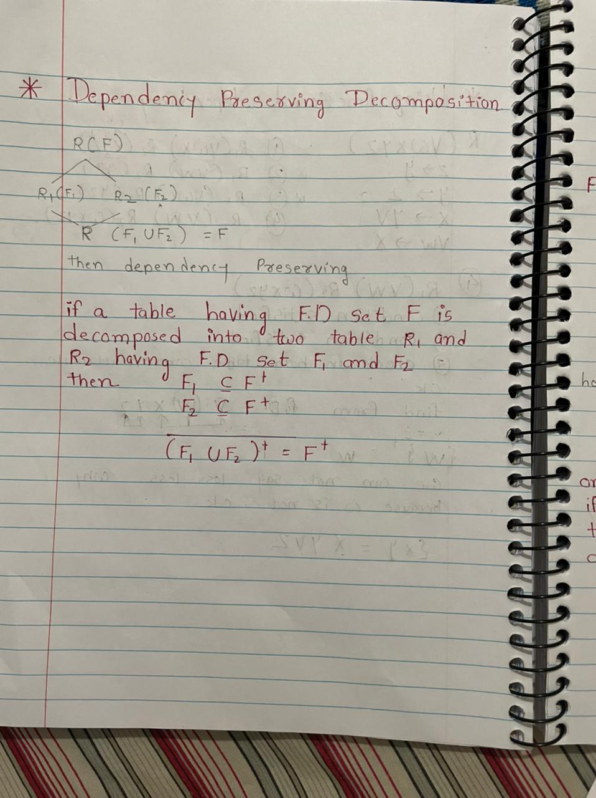
Dependency preserving Decomposition
Table R having functional dependency F. we decompose table in to two table R1 and R2 and R1 contain F1 functional dependency and R2 contain F2 functional dependency. If union of R(F1 U F2) =F then Dependency preserving.

Slide 76
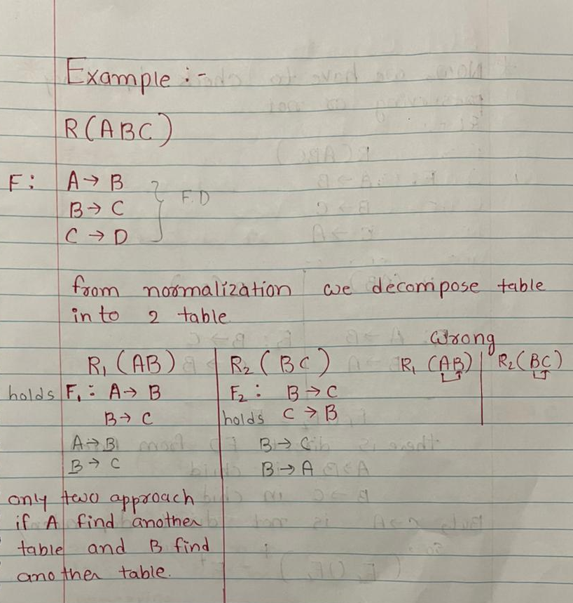
Example

Slide 77
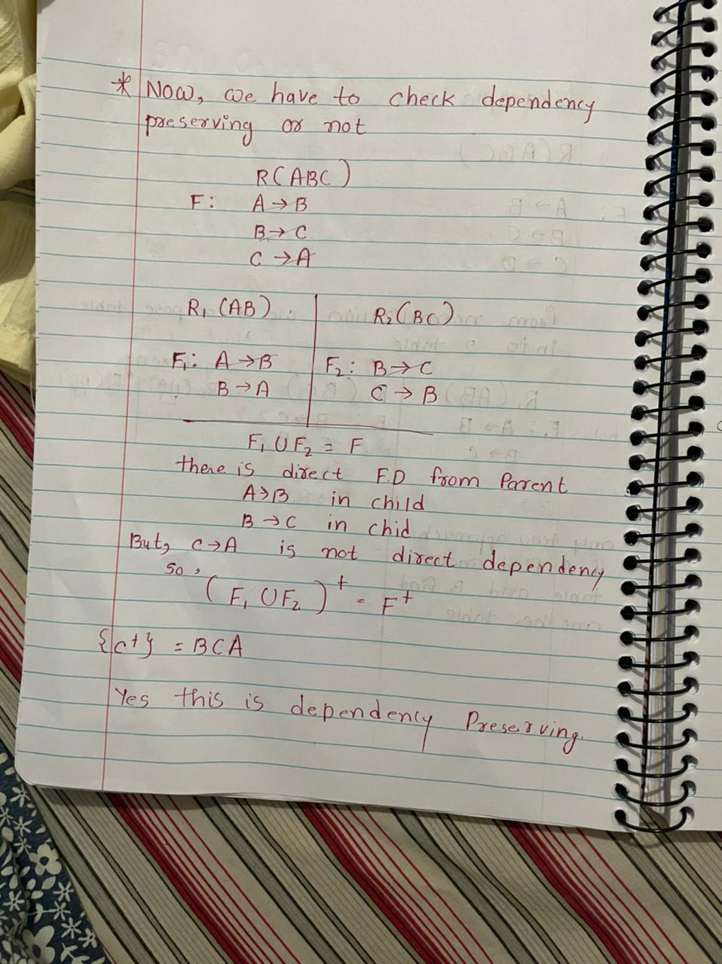

Slide 78
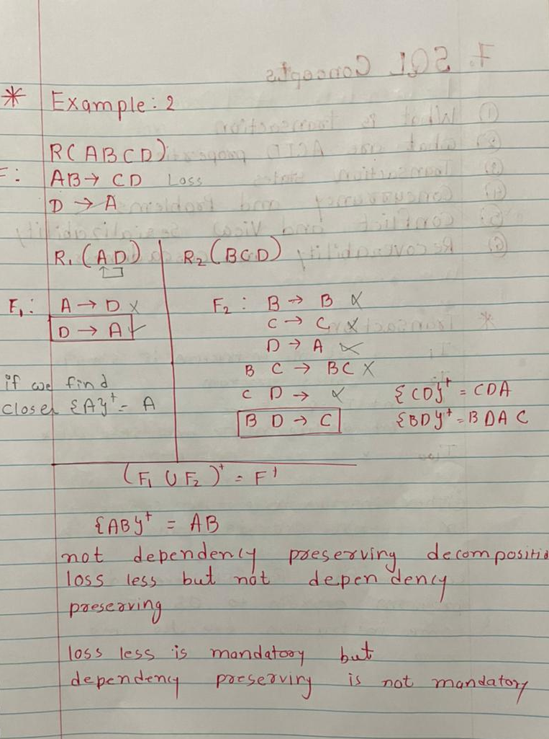
Example 2:

